Slide 1
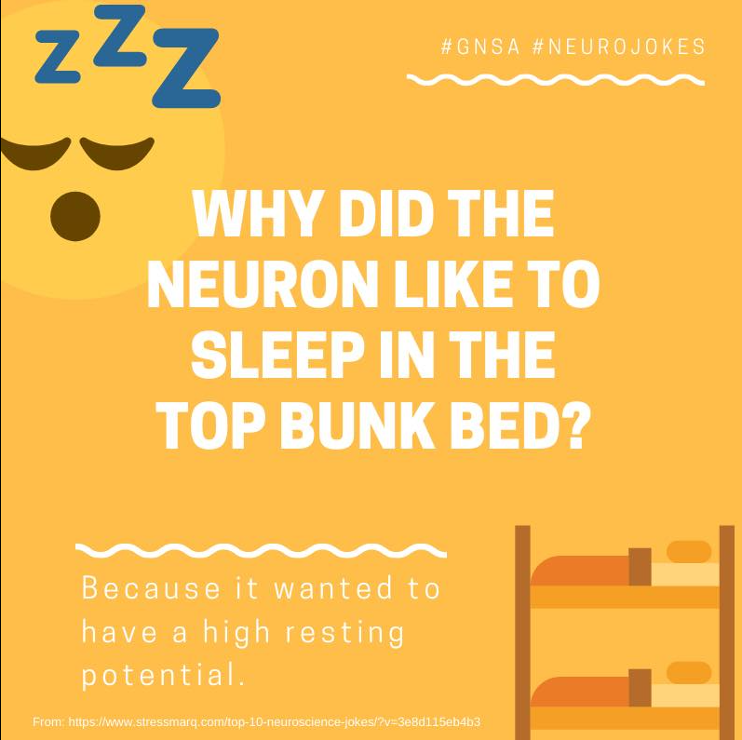
Date: | Human Biology Year 12 ATAR
Do Now Complete the past exam question given, using only your review worksheet or any hand written notes! Lesson Agenda 1: Do Now 2: Action Potentials – ppt presentation 3: Work on Review Worksheet: Action Potentials 4: Lesson summary and wind-up Suggested Study Compulsory: Complete review worksheet, mark and correct using answer key on Connect. Read through today’s notes and textbook section Write out the steps involved in the action potential. NEXT LESSON Past Exam Question Synapses and neurotransmitters | Learning Aims Define the term “Action Potential (AP)” Describe the features of the neurone cell membrane that allow ion movement Describe features of the neurone cell membrane such as relative position and concentration of ions, membrane potential and channel activity during: Resting membrane Depolarisation Repolarisation Hyperpolarisation Return to rest Define the term “refractory period” and explain its importance in AP transmission Explain how an AP propagates/transmits along the membrane Describe what occurs during saltatory conduction and its effect on AP transmission
 | Key Vocabulary Membrane Potential Depolarisation Repolarisation Hyperpolaristion Action Potential Propagation

Slide 2
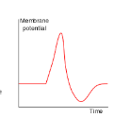
Nerve Impulses – Action Potentials
Ch 3 Neurons Communicate Quickly

Slide 3
Nerve Impulses
A nerve impulse message that travels along a nerve fibre (neuron)
Electrochemical change that travels along neuron cell membrane:
Changes in ion concentrations across the cell membrane
lead to
Changes in electrical voltage called Action Potentials (AP)
which
Travel as a wave along the axon
Can vary in speed of transmission:
Myelinated vs unmyelinated
Diameter of fibre: larger diameter = faster transmission
Fast response to stimulation
Learning Aim: Define the term “Action Potential (AP)”

Slide 4
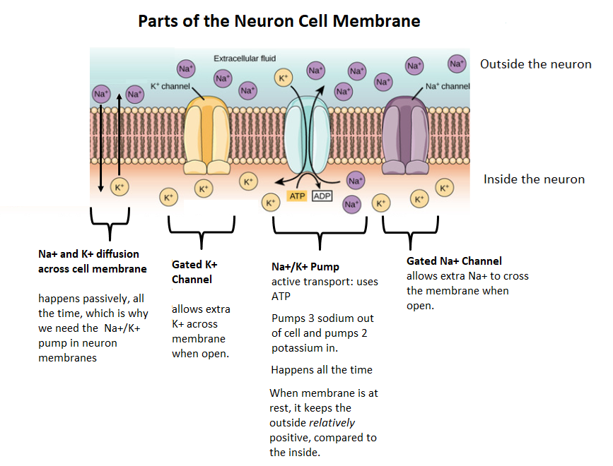
Learning Aim: Describe features of the neuron cell membrane that allow ion movement.

Slide 5
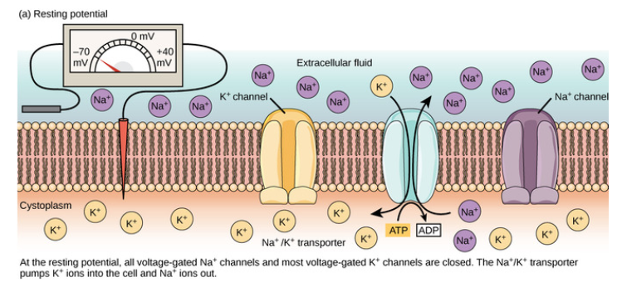
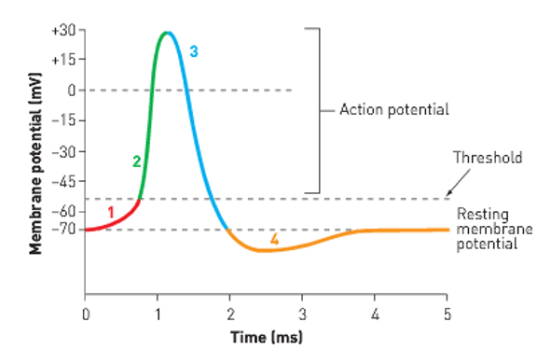
Resting Membrane Potential (RMP): Before Neuron is stimulated
Inside of neuron relatively negatively charged, compared to outside, because of Na+/K+ pump
Gated K+ and Na+ channels closed
Learning Aim: Describe features of the neurone cell membrane such as relative position and concentration of ions, membrane potential and channel activity during Resting Membrane Potential (RMP)

Slide 6
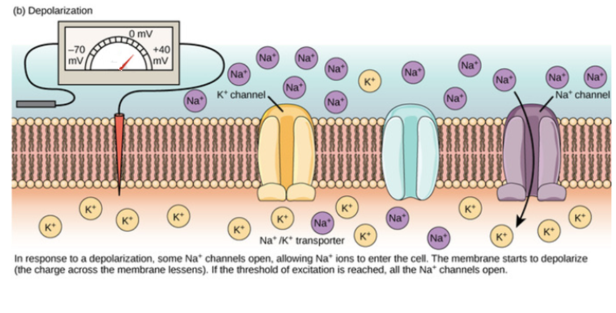
Depolarisation: when neuron is stimulated
Note:
If the threshold of -55mV is not reached, an Action Potential (AP) will not be triggered.
For each individual neuron, it’s an “all or nothing” response.
So, why do we feel it more if we drop a hammer on our foot compared to a slice of bread?
i: Local stimulation causes local changes in electrical potential by opening a few Na+ channels. (1)
ii: Threshold of excitation is reached -----
iii: Many gated Na+ Channels open
iv: Na+ floods across membrane (2)
v: Inside of cell is now relatively positive.
Learning Aim: Describe features of the neurone cell membrane such as relative position and concentration of ions, membrane potential and channel activity during Depolarisation

Slide 7
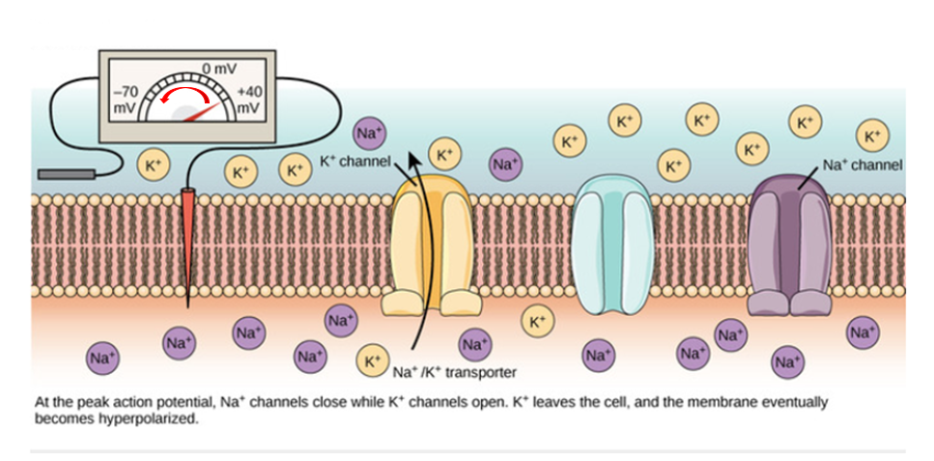
Repolarisation
At peak of action potential:
i: Gated K+ Channels open, and Na+ channels close
ii: K+ floods out across membrane (3)
iii: Charge begins to fall, back to -70mV
Learning Aim: Describe features of the neurone cell membrane such as relative position and concentration of ions, membrane potential and channel activity during Repolarisation

Slide 8
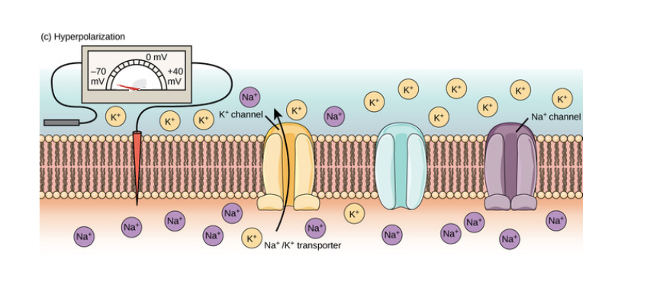
Hyperpolarisation
K+ channels remain open, and eventually the inside of the cell becomes even more negative than it was at rest. This is called hyperpolarisation. (4)
Note that now the K+ is on the outside, so it isn’t back to rest – the Na+/K+ pump needs to work to pump Na+ out and K+ in to regain resting potential.
Learning Aim: Describe features of the neurone cell membrane such as relative position and concentration of ions, membrane potential and channel activity during Hyperpolarisation

Slide 9
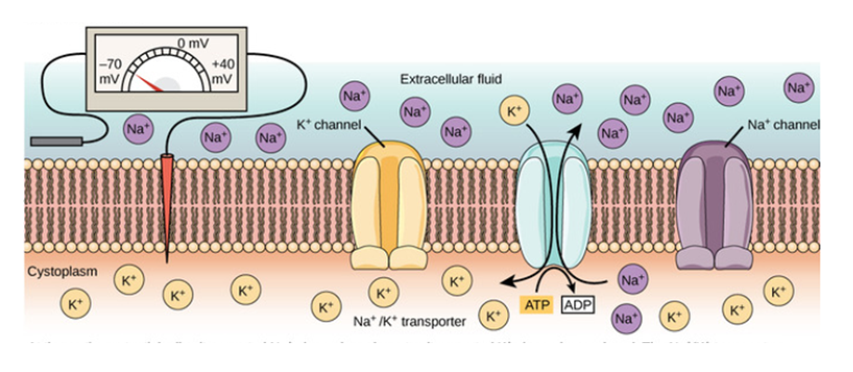
Return to Resting Membrane Potential (RMP)
Gated K+ channels close.
The Na+/K+ pump continues to work, eventually returning the membrane potential to resting status.
Learning Aim: Describe features of the neurone cell membrane such as relative position and concentration of ions, membrane potential and channel activity during return to RMP

Slide 10
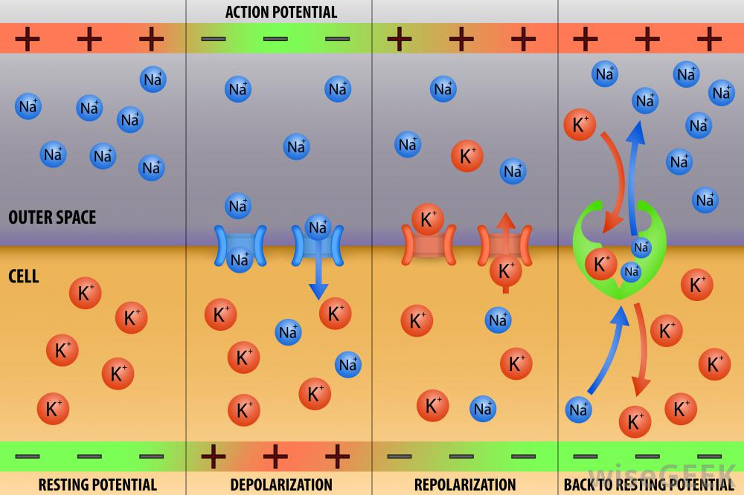
All the steps in one

Slide 11
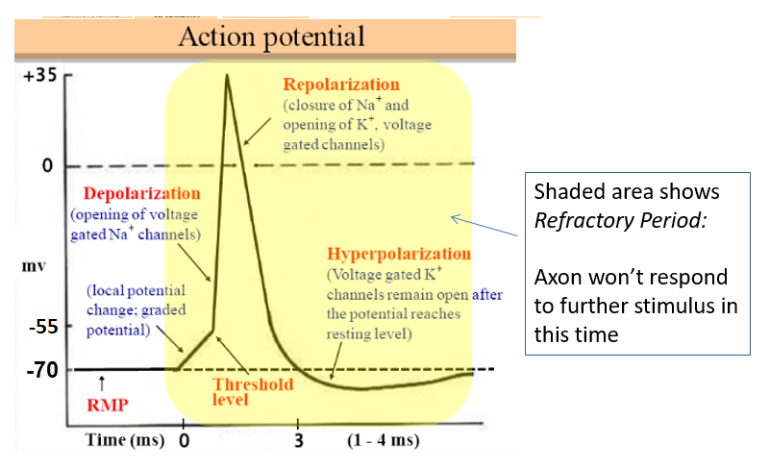
The Refractory Period
The refractory period is the reason an AP travels only in one direction along the membrane. (dendrites -> cell body -> axon)
Due to the concentration of ions on either side of the membrane and the membrane potential at this time, the section of membrane that has just had a wave of depolarisation can’t have another one, so the stimulus only moves to a section that has not already had an action potential.
Learning Aim: Define the term “refractory period” and explain its importance in AP transmission

Slide 12
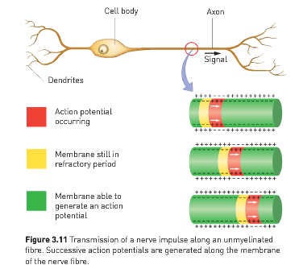
Propagation of AP along the neuron
An action potential in one section of membrane triggers a new one I the section of membrane immediately next to it, and so on down the neuron.
Learning Aim: Explain how the AP propagates/transmits along the neuron membrane

Slide 13
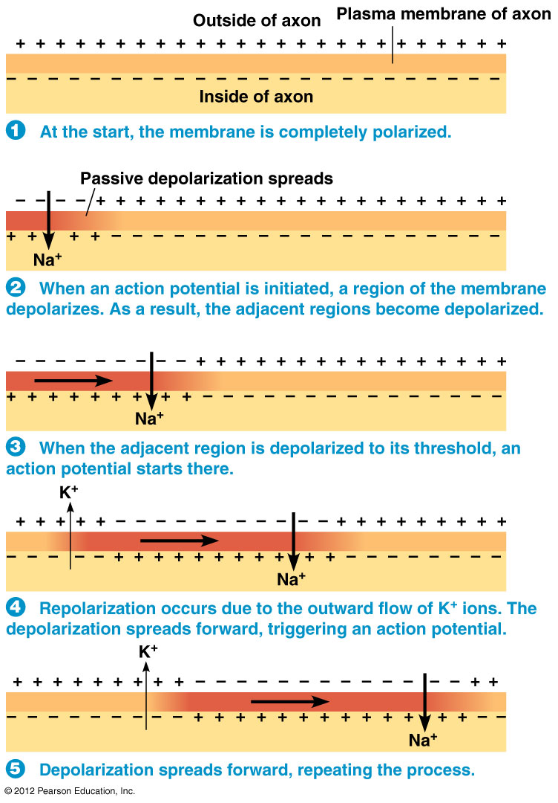

How an Action Potential Moves along an axon
Depolarisation in one part of the membrane triggers depolarisation in the next, just as when a domino falls, it pushes the next one over.
Learning Aim: Explain how the AP propagates/transmits along the neuron membrane

Slide 14
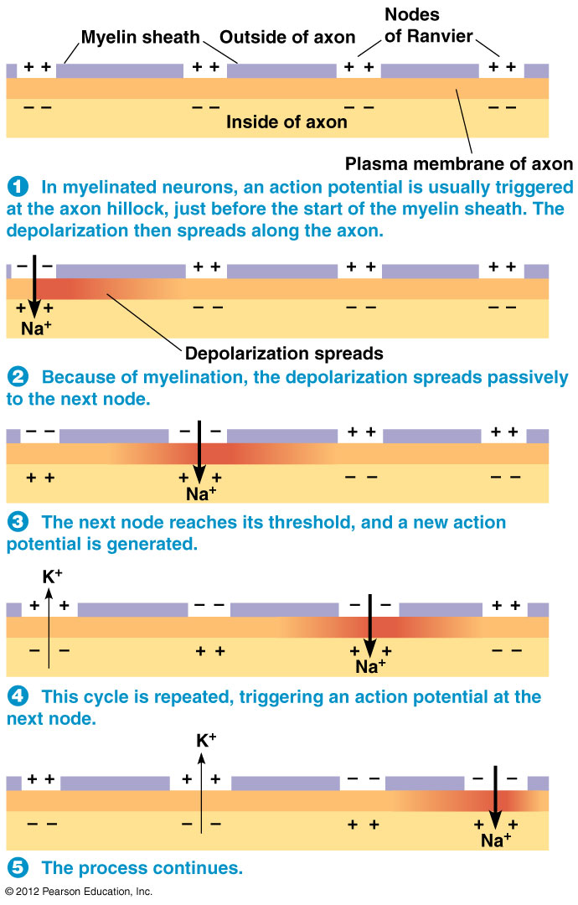
Action potentials along myelinated axons:
Saltatory Conduction.
Saltatory Conduction occurs in myelinated axons.
The myelin sheath covers sections of the cell membrane so that depolarisation can only occur at the nodes of Ranvier.
This means that the initial influx of sodium ions quickly diffuses to the next node, rather than triggering depolarisation in the membrane immediately next to it.
The sodium ions quickly and passively diffuse down the axon until the next node.
This makes the depolarisation jump from node to node, causing quicker transmission.
Learning Aim: Describe what occurs during saltatory conduction and its effect on AP transmission

Slide 15
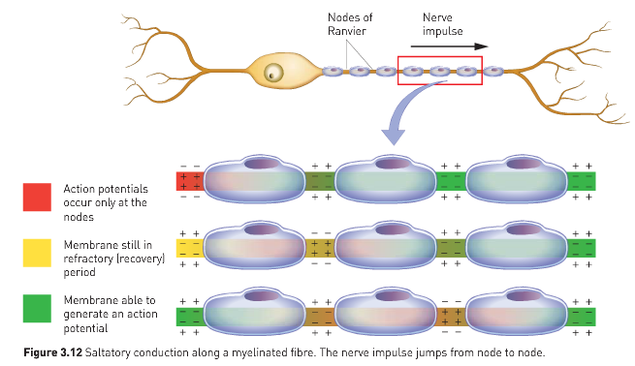
Learning Aim: Describe what occurs during saltatory conduction and its effect on AP transmission

Slide 16
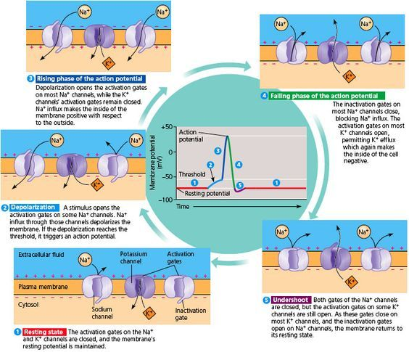
An extra diagram showing the same things about the AP cycle but in a different format….

